Slide 1
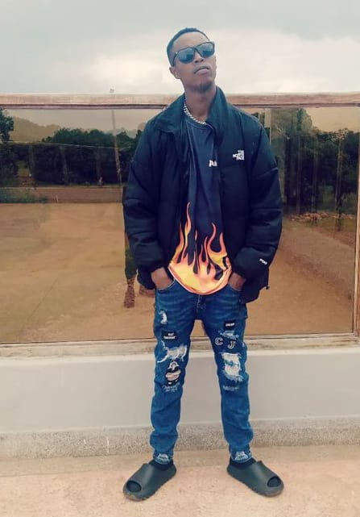
My Autobiography
I'm Samuel Kariuki Maina, and I'm thrilled to share my life story with you. It's a journey filled with ups and downs, lessons learned, and unforgettable moments.
Samuel Kariuki

Slide 2
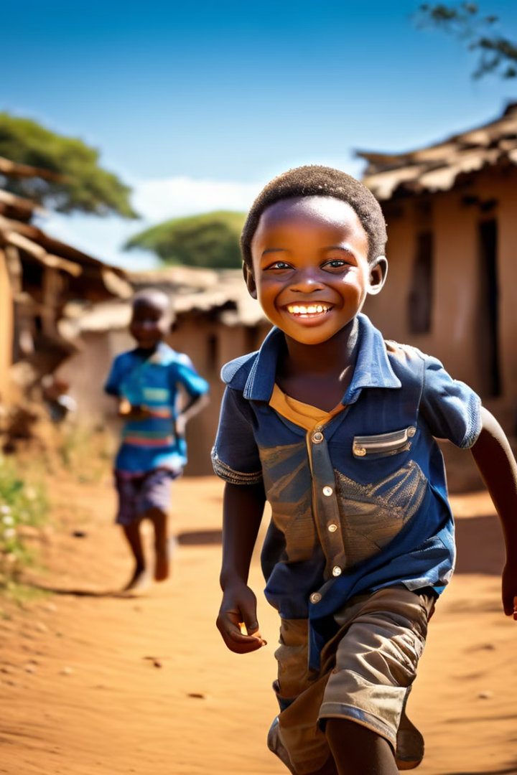
My Childhood in Nakuru, Kenya
Early Life
I was born into a loving family in Nakuru, Kenya, where I spent my childhood.
Family Life
My parents, Jane Waweru and Musa Mwangi, have always been my pillars of support.
Community Life
My childhood was filled with the vibrant energy of Nakuru, with its friendly people and cultural events.

Slide 3
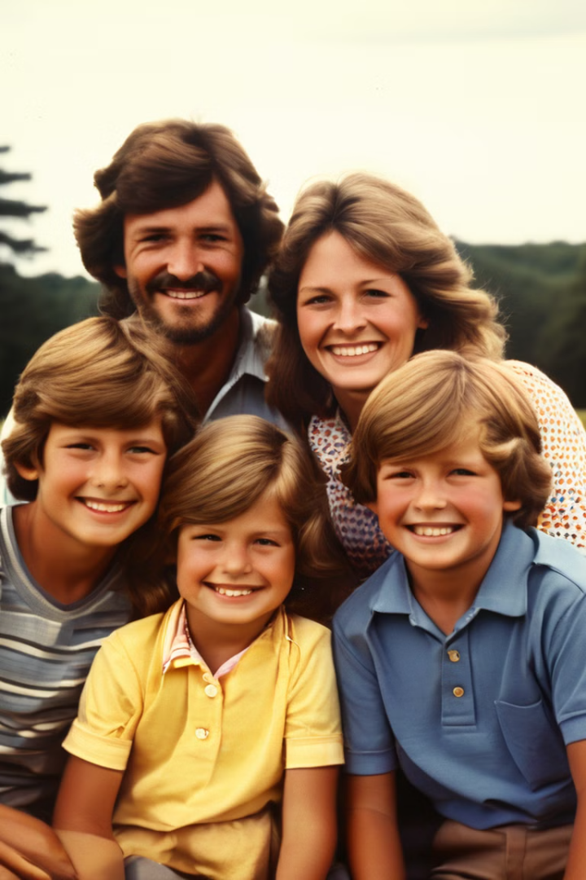
Growing Up in a Family of Six
1
Sibling Bonds
I have three brothers and one sister. We’ve always shared a strong bond, supporting each other through thick and thin.
2
Family Values
Our family instilled values of hard work, compassion, and respect for others. These values have shaped who I am today.
3
Childhood Memories
My childhood was filled with laughter, shared meals, and countless adventures with my siblings.

Slide 4

Navigating Challenges and Triumphs
1
Academic Challenges
School wasn't always easy, but I learned to persevere through challenges and overcome obstacles.
2
Personal Growth
Each challenge I faced helped me grow as a person, developing resilience and a strong work ethic.
3
Building Confidence
I learned to embrace my strengths and weaknesses, building confidence and self-awareness along the way.

Slide 5
Education and Pursuit of Knowledge
Early Education
Higher Education
Lifelong Learning
My early education took place in Nakuru, where I learned the basics and developed a love for learning.
I pursued higher education, graduating with a degree in [insert relevant degree] from [insert university name].
I'm a firm believer in lifelong learning. I continue to seek out opportunities to expand my knowledge and skills.

Slide 6




My Professional Journey
Early Career
My professional journey began with an internship in [insert industry]. This experience ignited my passion for [insert career field].
Career Growth
I progressed through various roles, gaining valuable experience and building my expertise in [insert relevant skills].
Leadership and Impact
I've had the privilege of leading teams, contributing to meaningful projects, and making a positive impact in my field.

Slide 7

Relationships and Family Life
Family
I cherish my family and the strong bonds we share. They are my rock and my source of strength.
Friendships
I have a circle of close friends who have enriched my life with laughter, support, and shared experiences.
Relationships
I've learned the importance of healthy relationships, based on mutual respect, trust, and understanding.

Slide 8




Reflections and Future Aspirations
Continuous Learning
I am committed to continuous learning and growth, both professionally and personally.
Giving Back
I believe in giving back to my community and making a positive contribution to society.
Family First
My family remains my priority. I cherish the time I spend with them and strive to create lasting memories.

